Slide 1



What we know
(don’t)
^
… about being productive and finding meaning at work
dishopch@msu.edu
Cdishop
Christopher R. Dishop

Slide 2
Agenda
Selection
Teams
Methods
Meaningful
Work
Performance
Diversity

Slide 3
Agenda
What we know
Selection
Teams
Methods
Meaningful
Work
Performance
Diversity

Slide 4
Agenda
What we know
Selection
Teams
Methods
Meaningful
Work
Performance
Diversity
What we don’t know

Slide 5
Agenda
MSU | Grad School | Career Path

Slide 6
Caveat
Notes:
Correlational. External validity.
Low on data, high on buzzwords. I was going to present my dissertation
But I was asked to keep it basic. So I’m keeping it basic.

Slide 7
MEANINGFUL WORK

Slide 8
MEANINGFUL WORK
- Engaged
- Satisfied

Slide 9
Meaningful Work
What we know

Slide 10
Meaningful Work
What we know
Job Characteristics Model

Slide 11
Meaningful Work
Autonomy
Identity
Significance
Feedback
Skill Variety
What we know

Slide 12
Meaningful Work
Autonomy
Identity
Significance
Feedback
Skill Variety
What we know

Slide 13
Meaningful Work
Autonomy
Identity
Significance
Feedback
Skill Variety
What we know

Slide 14
Meaningful Work
Autonomy
Identity
Significance
Feedback
Skill Variety
What we know

Slide 15
Meaningful Work
Autonomy
Identity
Significance
Feedback
Skill Variety
What we know

Slide 16
Meaningful Work
Autonomy
Identity
Significance
Feedback
Skill Variety
What we know

Slide 17
Meaningful Work
Autonomy
Identity
Significance
Feedback
Skill Variety
Uniquely Valuable
What we know

Slide 18
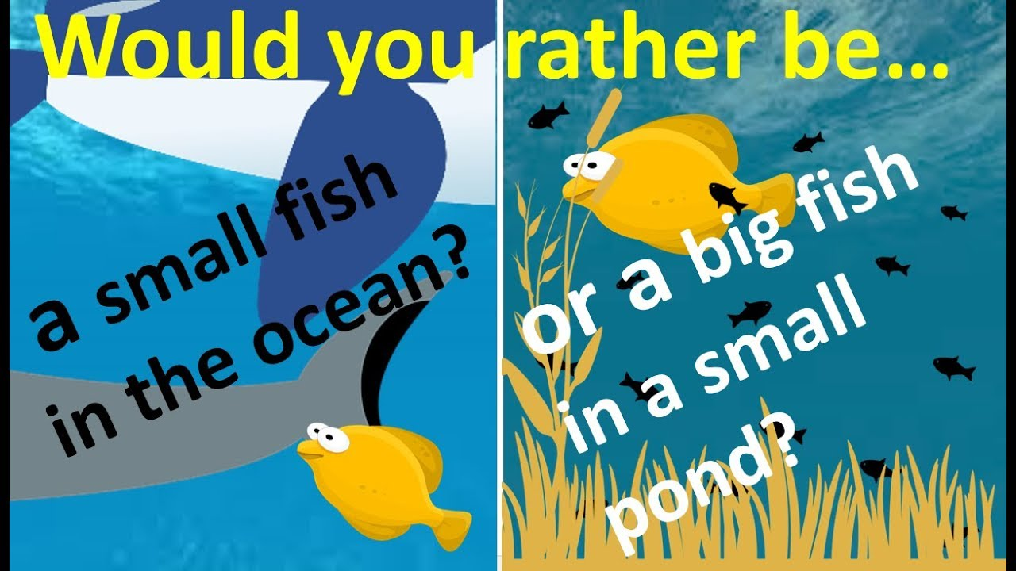
Meaningful Work
Autonomy
Identity
Significance
Feedback
Skill Variety
Uniquely Valuable
What we know

Slide 19
Meaningful Work
Autonomy
Identity
Significance
Feedback
Skill Variety
Uniquely Valuable
What we know
Notes:
https://www.youtube.com/watch?v=cGfLZWQUD4g
https://www.youtube.com/watch?v=_woAZTe5YBw

Slide 20
Meaningful Work
What we know
☹️

Slide 21
Meaningful Work
Follow your passion
What we know
☹️

Slide 22
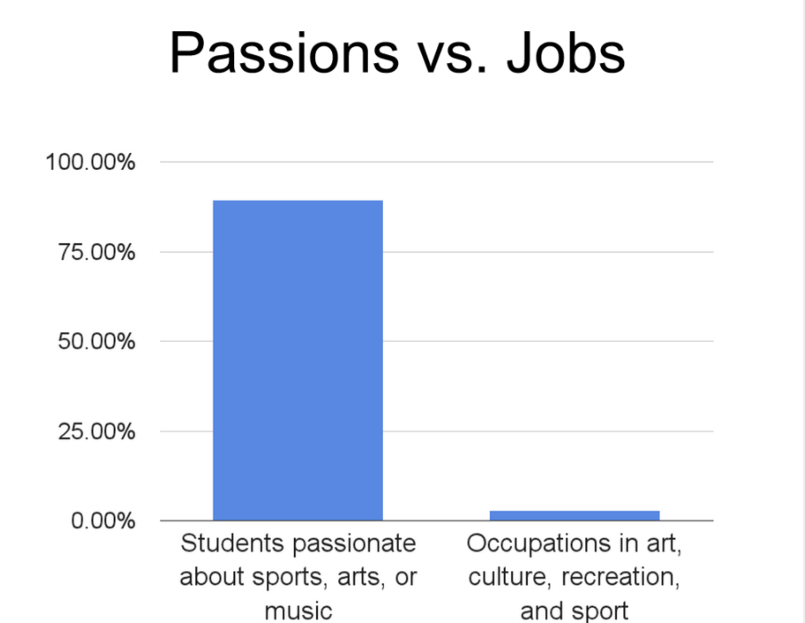
Meaningful Work
Follow your passion
What we know
☹️

Slide 23
Meaningful Work
Follow your passion
What we know
☹️
“We are all passionate about music, art, sex, and sports. There are no jobs in those industries.” - Freakonomics

Slide 24
Meaningful Work
Follow your passion
Commute time
What we know
☹️
☹️

Slide 25
Meaningful Work
What we don’t know

Slide 26


Meaningful Work
Limits
Technology & Social Media
What we don’t know

Slide 27
Individual Performance & Career Success

Slide 28
Individual Performance & Career Success
- Effective
- Ladder

Slide 29
Individual Success
What we know

Slide 30

Individual Success
What we know

Slide 31
Individual Success
What we know
Cognitive Ability

Slide 32
Individual Success
What we know
Cognitive Ability
Assertive
Optimism
Conscientiousness

Slide 33
Individual Success
What we know
Cognitive Ability
Assertive
Optimism
Conscientiousness
Learning, Writing, Communicating

Slide 34
Individual Success
What we know
Cognitive Ability
Assertive
Optimism
Conscientiousness
Learning, Writing, Communicating
Parents
Social Support
Climate

Slide 35
Individual Success
What we know
Human Capital Investments
Cognitive Ability
Assertive
Optimism
Conscientiousness
Learning, Writing, Communicating
Parents
Social Support
Climate

Slide 36
Individual Success
What we know
Environment
State
Notes:
Self regulation. Connects person and environment. Something I study. What is the link between someone performing, the feedback he gets from the envioronment, and so on.
Goals. Rewards

Slide 37
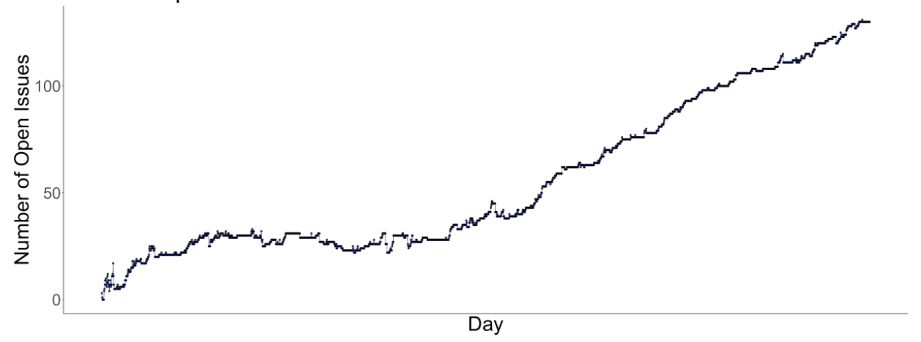
Individual Success
What we know

Slide 38
Individual Success
What we know
Environment
State
Notes:
Monitor a state. I don’t mean conscieously perceiving at all times. What I really mean is monitoring discrepancies. You monitor your temperature. You don’t check it with a thermometer every hour…but when your temperature is 100 you very much notice.

Slide 39
Individual Success
What we don’t know

Slide 40
Individual Success
Translating
What we don’t know

Slide 41
Individual Success
Translating (Scientist Practitioner Gap)
What we don’t know

Slide 42
Individual Success
Translating (Scientist Practitioner Gap)
Protean & Boundaryless
What we don’t know

Slide 43
Team Performance

Slide 44
Team Performance
- Effective

Slide 45
Team Performance
What we know

Slide 46
Team Performance
Process Loss
What we know

Slide 47
Team Performance
Process Loss
What we know

Slide 48
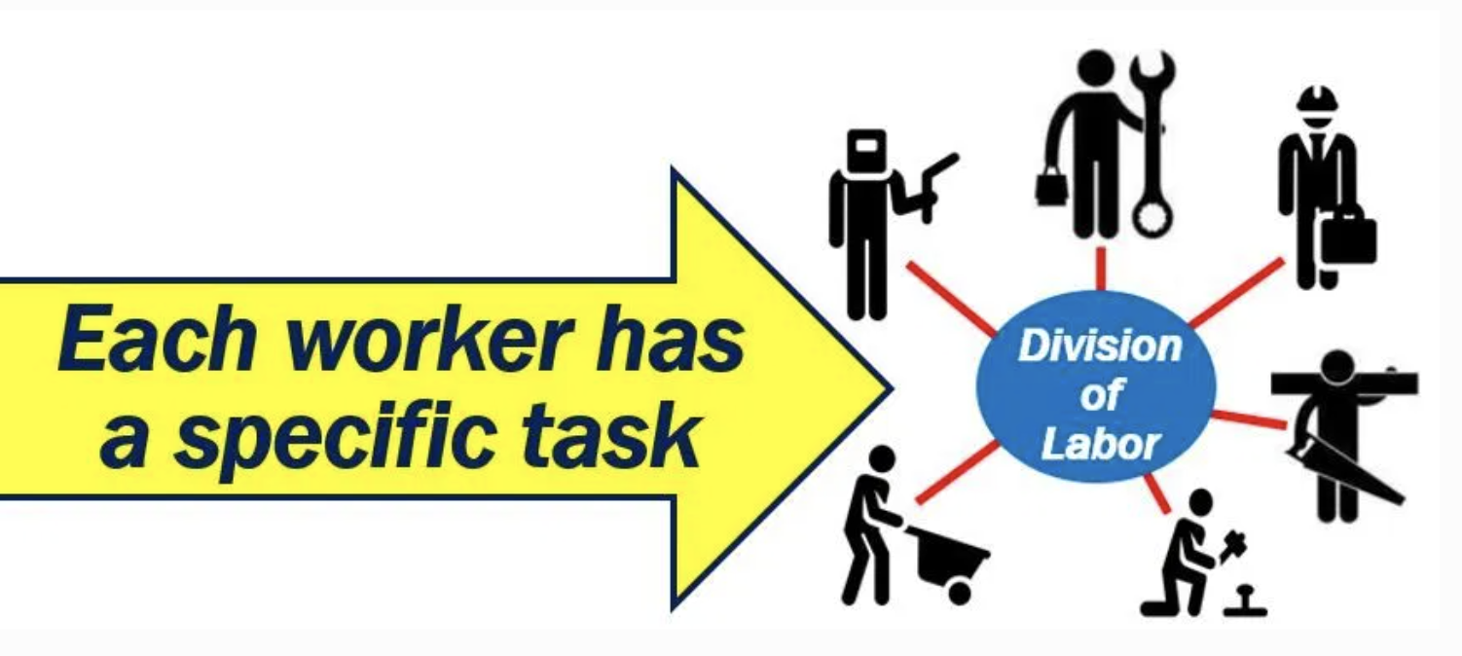
Team Performance
Process Loss
Division Of Labor
What we know

Slide 49
Team Performance
Process Loss
Division Of Labor
What we know

Slide 50
Team Performance
Process Loss
Division Of Labor
What we know
Hours to production

Slide 51
Team Performance
Process Loss
Division Of Labor
What we know
13
Hours to production
1

Slide 52
Team Performance
Process Loss
Division Of Labor
What we know
13
No
Assembly
Line
Hours to production
1

Slide 53
Team Performance
Process Loss
Division Of Labor
What we know
13
No
Assembly
Line
Hours to production
1
Assembly Line
Notes:
Henry Ford broke the assembly task into 84 discrete steps and trained workers to do just one step to increase his factories’ productivity. This reduced the production time of a car from 12.5 hours to 93 minutes. Production figures compiled from the Model T Comprehensive Encyclopedia show that production before the assembly line was introduced in 1913 averaged 68,773 cars per year. In 1913, production increased to 170,211 cars in a year (McCalley, 1989).
Each worker focuses on one task and specializes
No transition times
By focusing on one task, you can be creative and change it slightly to make it better

Slide 54
Team Performance
Process Loss
Division Of Labor
Wisdom Of Crowds
What we know

Slide 55

Team Performance
Process Loss
Division Of Labor
Wisdom Of Crowds
What we know

Slide 56
Team Performance
Process Loss
Division Of Labor
Wisdom Of Crowds
What we know
1900
2000
1100
1200

Slide 57
Team Performance
Process Loss
Division Of Labor
Wisdom Of Crowds
What we know
1900
2000
1100
1200

Slide 58
Team Performance
Process Loss
Division Of Labor
Wisdom Of Crowds
What we know
1900
2000
1100
1200
1550

Slide 59
Team Performance
Process Loss
Division Of Labor
Wisdom Of Crowds
What we know
1900
2000
1100
1200
1550 =

Slide 60
Team Performance
Process Loss
Division Of Labor
Wisdom Of Crowds
Diversity
What we know

Slide 61


Team Performance
Process Loss
Division Of Labor
Wisdom Of Crowds
Diversity
What we know

Slide 62
Team Performance
Process Loss
Division Of Labor
Wisdom Of Crowds
Diversity
Levers
What we know

Slide 63
Team Performance
Process Loss
Division Of Labor
Wisdom Of Crowds
Diversity
Levers
What we know
Shared Vision | Transactive Memory | Leadership

Slide 64
Team Performance
Judi Komaki
What we know

Slide 65
Team Performance
Judi Komaki
What we know
0
65
Observation Period (Day)

Slide 66
Team Performance
Judi Komaki
What we know
100
% Safety Behaviors
0
0
65
Observation Period (Day)

Slide 67
Team Performance
Judi Komaki
What we know
100
% Safety Behaviors
0
– Baseline
0
65
Observation Period (Day)

Slide 68
Team Performance
Judi Komaki
What we know
100
% Safety Behaviors
0
– Baseline
– Intervention
0
65
Observation Period (Day)

Slide 69
Team Performance
Judi Komaki
What we know
100
% Safety Behaviors
0
– Baseline
– Intervention
– Reversal
0
65
Observation Period (Day)

Slide 70
Team Performance
Process Loss
Division Of Labor
Wisdom Of Crowds
Diversity
Levers
Cooperation
What we know

Slide 71
Dishop, C. R., & DeShon, R. P. (2020). What is the critical mass of help? A potential resolution to a paradox on citizenship and organizational performance. Computational & Mathematical Organization Theory, 1-15.
Team Performance
What we know

Slide 72
Dishop, C. R., & DeShon, R. P. (2020). What is the critical mass of help? A potential resolution to a paradox on citizenship and organizational performance. Computational & Mathematical Organization Theory, 1-15.
Team Performance
What we know
Helping
Performing

Slide 73
Dishop, C. R., & DeShon, R. P. (2020). What is the critical mass of help? A potential resolution to a paradox on citizenship and organizational performance. Computational & Mathematical Organization Theory, 1-15.
Team Performance
What we know
Helping
Performing
Collective Performance

Slide 74
Dishop, C. R., & DeShon, R. P. (2020). What is the critical mass of help? A potential resolution to a paradox on citizenship and organizational performance. Computational & Mathematical Organization Theory, 1-15.
Team Performance
What we know
Helping
Performing
Collective Performance
# People Helping

Slide 75
Dishop, C. R., & DeShon, R. P. (2020). What is the critical mass of help? A potential resolution to a paradox on citizenship and organizational performance. Computational & Mathematical Organization Theory, 1-15.
Team Performance
What we know
Helping
Performing
Collective Performance
# People Helping

Slide 76
Dishop, C. R., & DeShon, R. P. (2020). What is the critical mass of help? A potential resolution to a paradox on citizenship and organizational performance. Computational & Mathematical Organization Theory, 1-15.
Team Performance
What we know
Helping
Performing
Collective Performance
# People Helping

Slide 77
Dishop, C. R., & DeShon, R. P. (2020). What is the critical mass of help? A potential resolution to a paradox on citizenship and organizational performance. Computational & Mathematical Organization Theory, 1-15.
Team Performance
What we know
Helping
Performing
Collective Performance
# People Helping

Slide 78
Dishop, C. R., & DeShon, R. P. (2020). What is the critical mass of help? A potential resolution to a paradox on citizenship and organizational performance. Computational & Mathematical Organization Theory, 1-15.
Team Performance
What we know
Helping
Performing
Collective Performance
# People Helping

Slide 79
Dishop, C. R., & DeShon, R. P. (2020). What is the critical mass of help? A potential resolution to a paradox on citizenship and organizational performance. Computational & Mathematical Organization Theory, 1-15.
Team Performance
What we know
Helping
Performing
Collective Performance
# People Helping

Slide 80
Dishop, C. R., & DeShon, R. P. (2020). What is the critical mass of help? A potential resolution to a paradox on citizenship and organizational performance. Computational & Mathematical Organization Theory, 1-15.
Team Performance
What we know
Helping
Performing
Collective Performance
# People Helping

Slide 81
Team Performance
What we don’t know

Slide 82
Team Performance
Beyond lab
What we don’t know

Slide 83
Team Performance
Beyond lab
Congruent explanations
What we don’t know
Notes:
This is the nice way to say it. The mean way to say it is that there is a tendency to provide explanations that are abstract, boring, and unhelpful. Not intellectually deep.

Slide 84

Team Performance
Beyond lab
Congruent explanations
What we don’t know

Slide 85
Team Performance
What we don’t know
Lever | Description
Conditions | Is the context favorable to performing well?

Slide 86
Methods

Slide 87
Methods
Scale Development

Slide 88

Methods
Scale Development

Slide 89
Methods
Scale Development

Slide 90
Methods
Meta Analysis

Slide 91
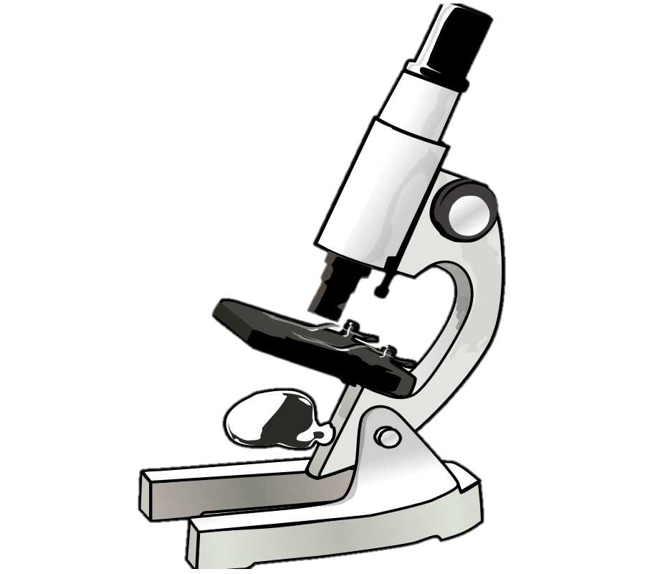
Autonomy => Satisfaction
Methods
Meta Analysis

Slide 92

Autonomy => Satisfaction
Methods
Meta Analysis
Autonomy => Satisfaction

Slide 93

Autonomy => Satisfaction
Methods
Meta Analysis
Autonomy => Satisfaction
Autonomy => Satisfaction

Slide 94
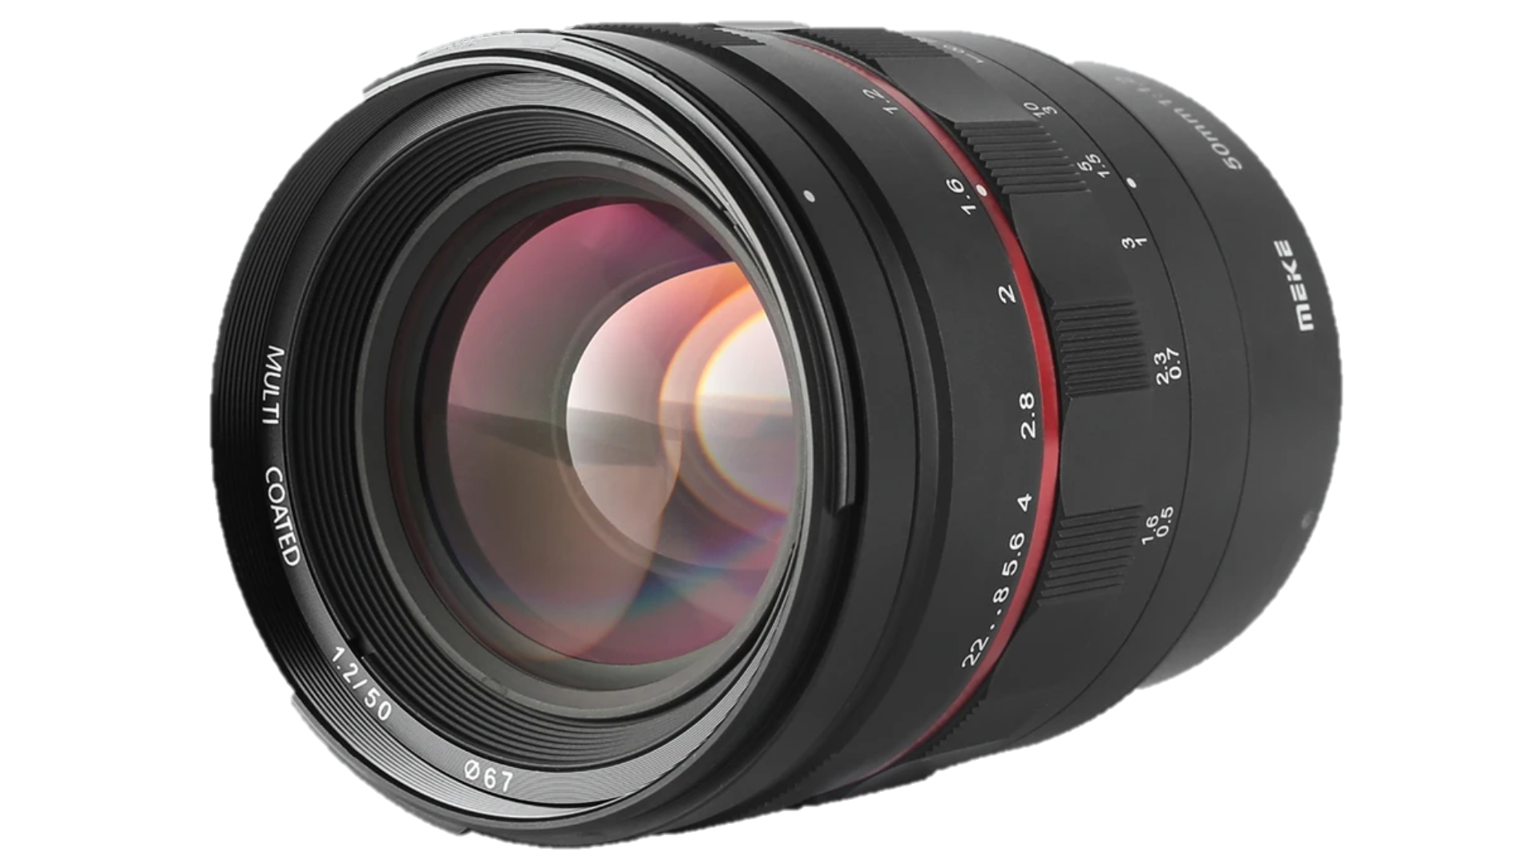
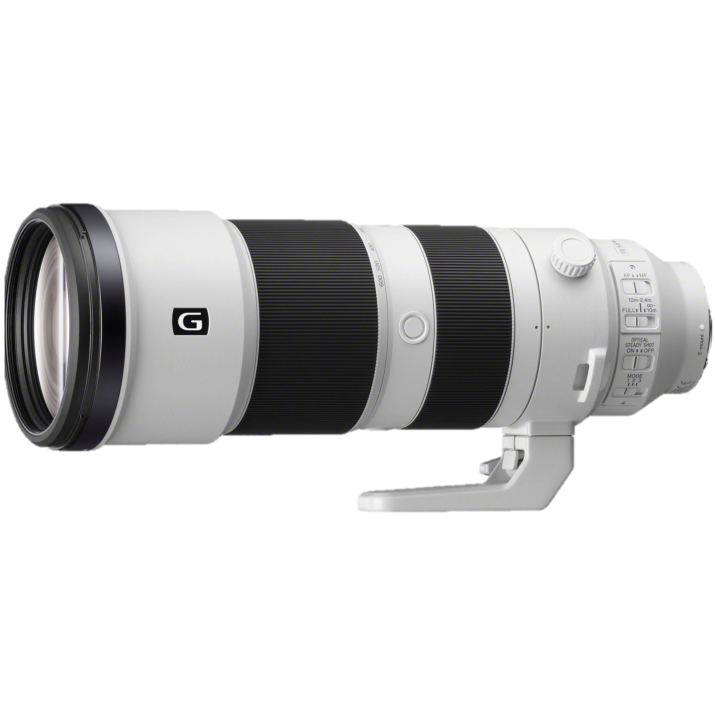
Autonomy => Satisfaction
Methods
Meta Analysis
Autonomy => Satisfaction
Autonomy => Satisfaction
Autonomy => Satisfaction
Autonomy => Satisfaction

Slide 95

Autonomy => Satisfaction
Autonomy => Satisfaction
Autonomy => Satisfaction
Autonomy => Satisfaction
Autonomy => Satisfaction
Autonomy => Satisfaction

Slide 96
Autonomy => Satisfaction
Autonomy => Satisfaction
Autonomy => Satisfaction
Autonomy => Satisfaction
Autonomy => Satisfaction
Autonomy => Satisfaction

Slide 97
Autonomy => Satisfaction
Autonomy => Satisfaction
Autonomy => Satisfaction
Autonomy => Satisfaction
=>
Autonomy => Satisfaction
Autonomy => Satisfaction

Slide 98
Methods
Dynamics

Slide 99
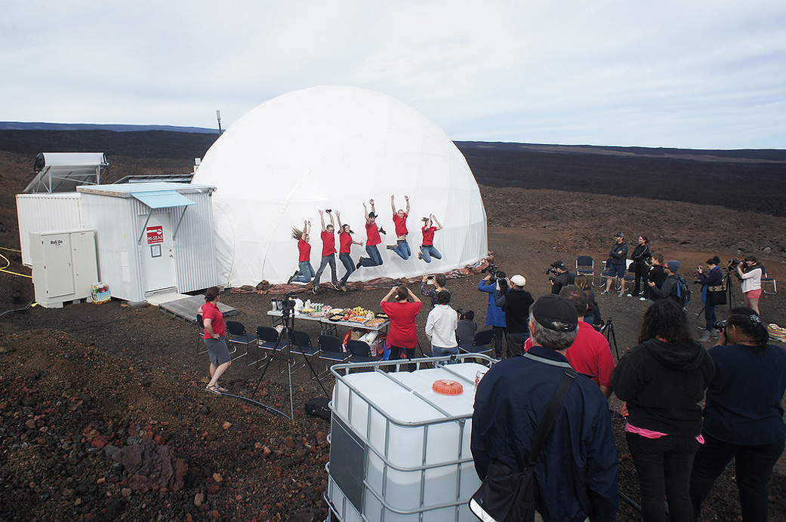
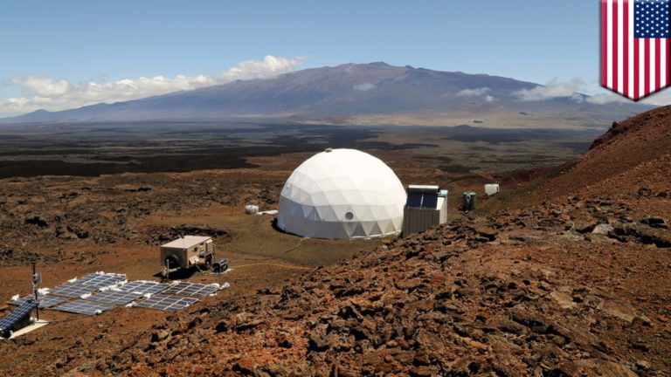
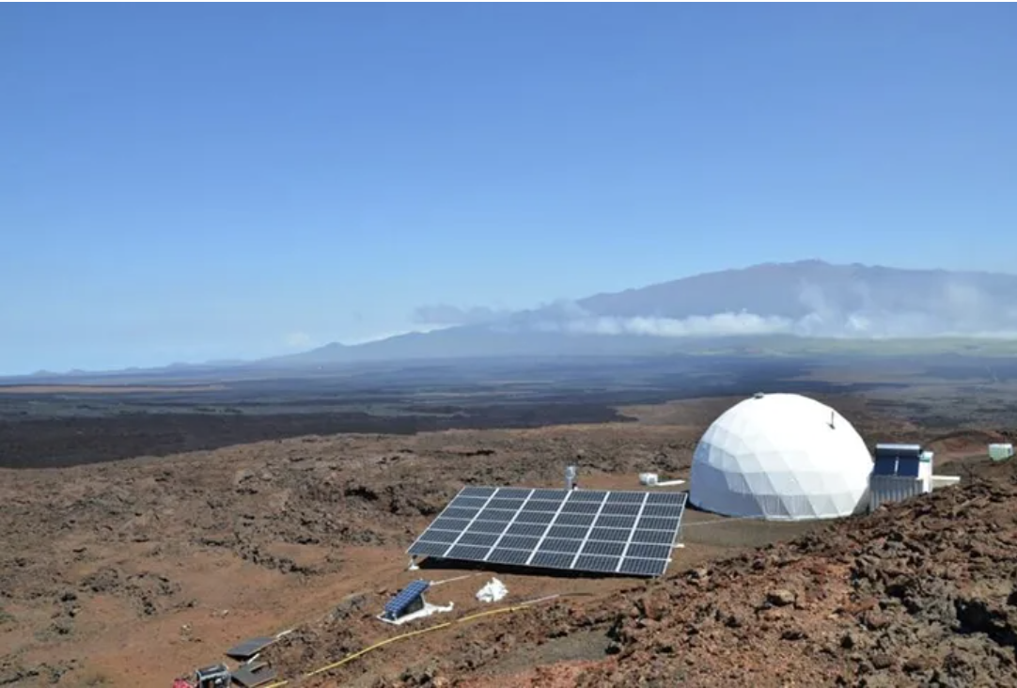

Slide 100
Methods
Computational Modeling

Slide 101

Methods
Computational Modeling

Slide 102
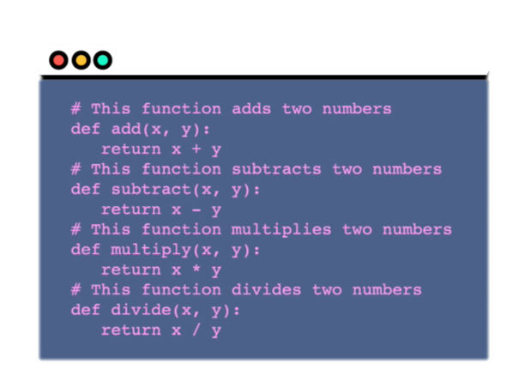
Methods
Computational Modeling
Notes:
https://www.washingtonpost.com/graphics/2020/world/corona-simulator/

Slide 103
Caveat
Notes:
Applied
Interviews
Leadership
Staffing or pay or group formation
Interests
Stress, Safety, Health and Well-being

Slide 104
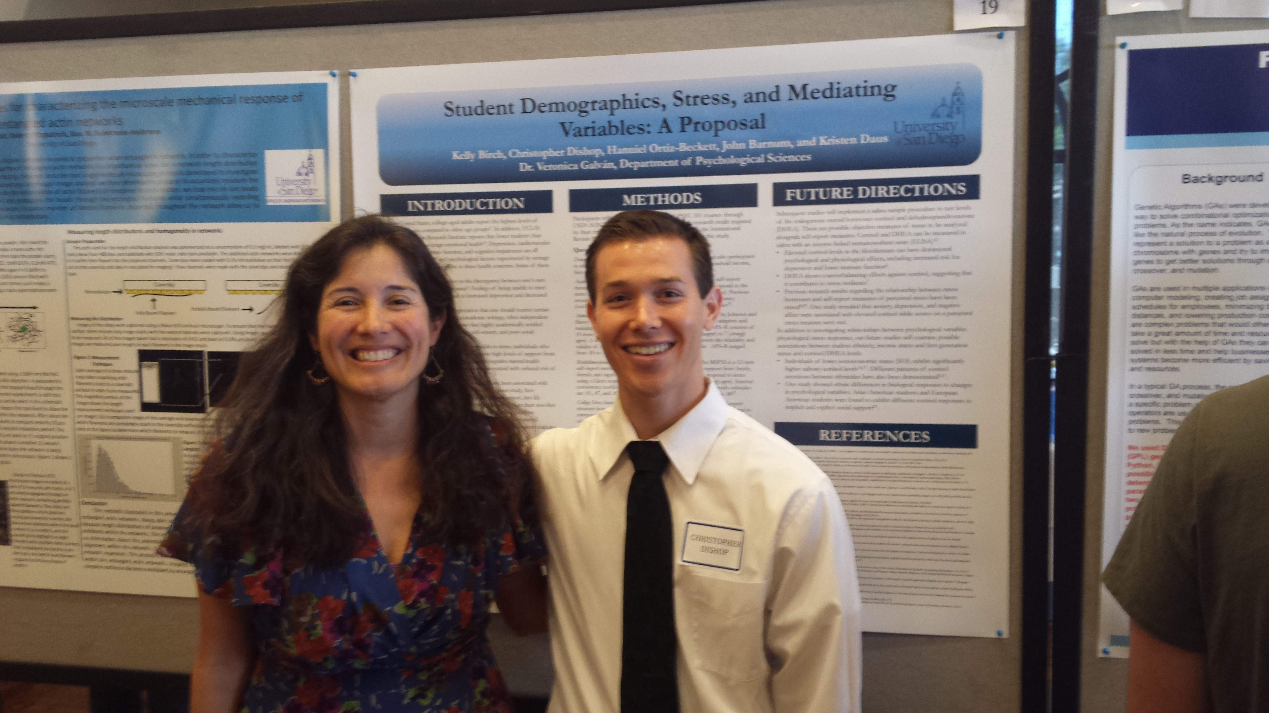
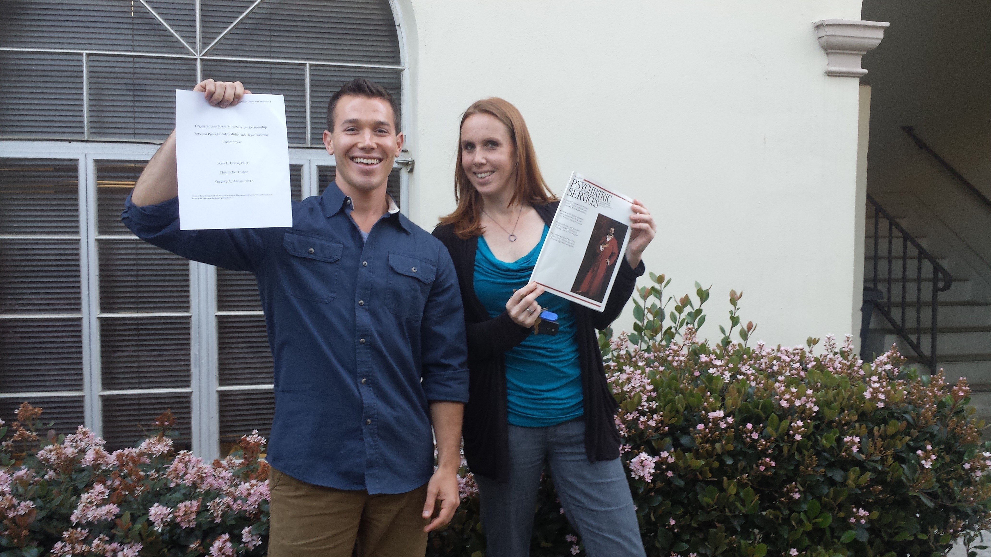
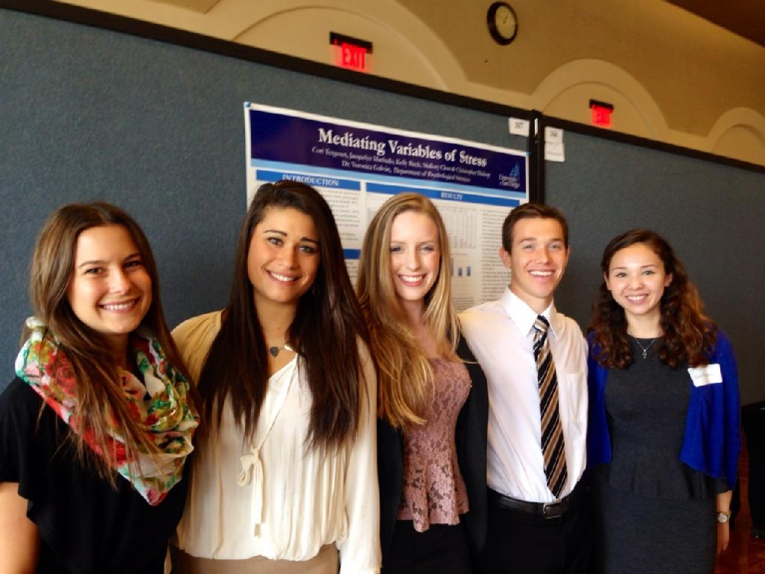
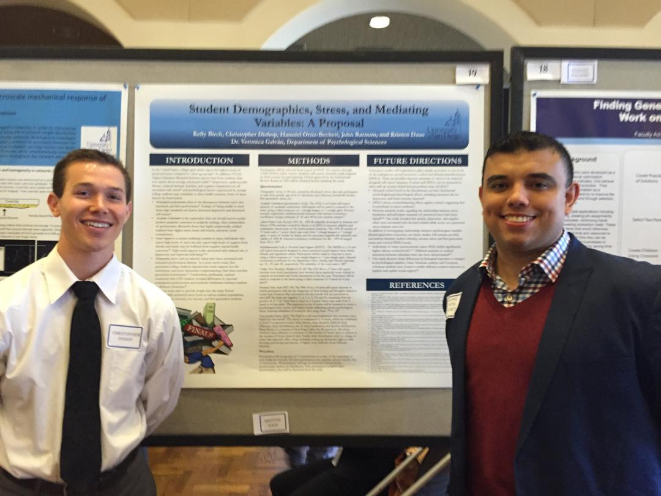

Slide 105
dishopch@msu.edu

